Slide 1
Fundamentals Of Web Design
Sneaker Store
Mohammed Sawan
202311222

Slide 2



About the project
My project is a Sneaker Store that offers different types of sneakers. It has a Home Page, Products Page , a Cart , and a About me page

Slide 3




Color Scheme
color | Hexadecimal Value | Used for
 | #000000 & #FFFFFF | Font
 | #007bff & #dc3545 | button
 | #FFFFFF & #000000 | Header
 | #333 | Footer

Slide 4
Page Hierarchy
Home.html
Cart.html
Products.html
AboutMe.html

Slide 5
Pages
Home
Products
About Me
Cart
All pages except the about me page has a header and a footer
And the about me page has a button that takes u to home page instead

Slide 6
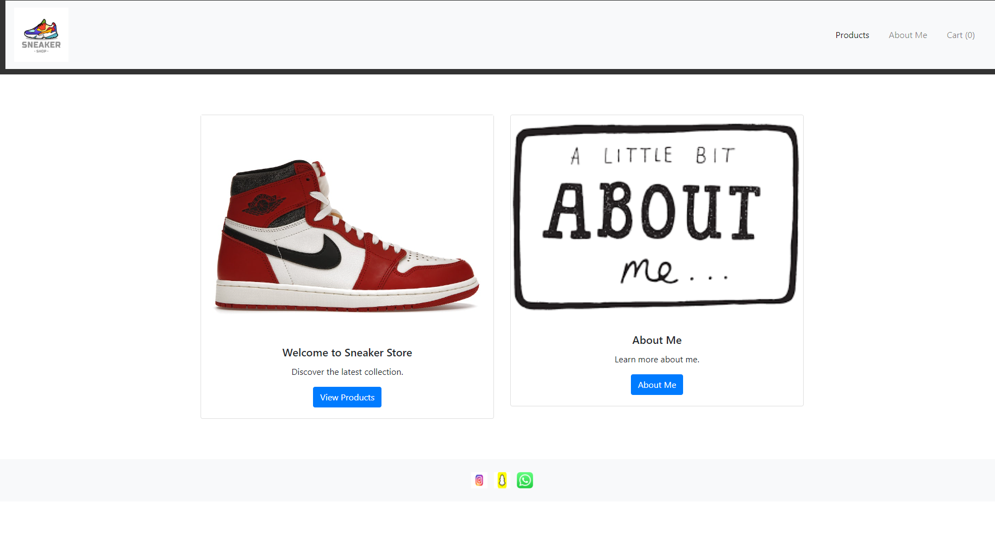
Home Page
Includes a header, footer, navigation buttons and a 2 buttons with pictures that takes you to the products and the about me page

Slide 7
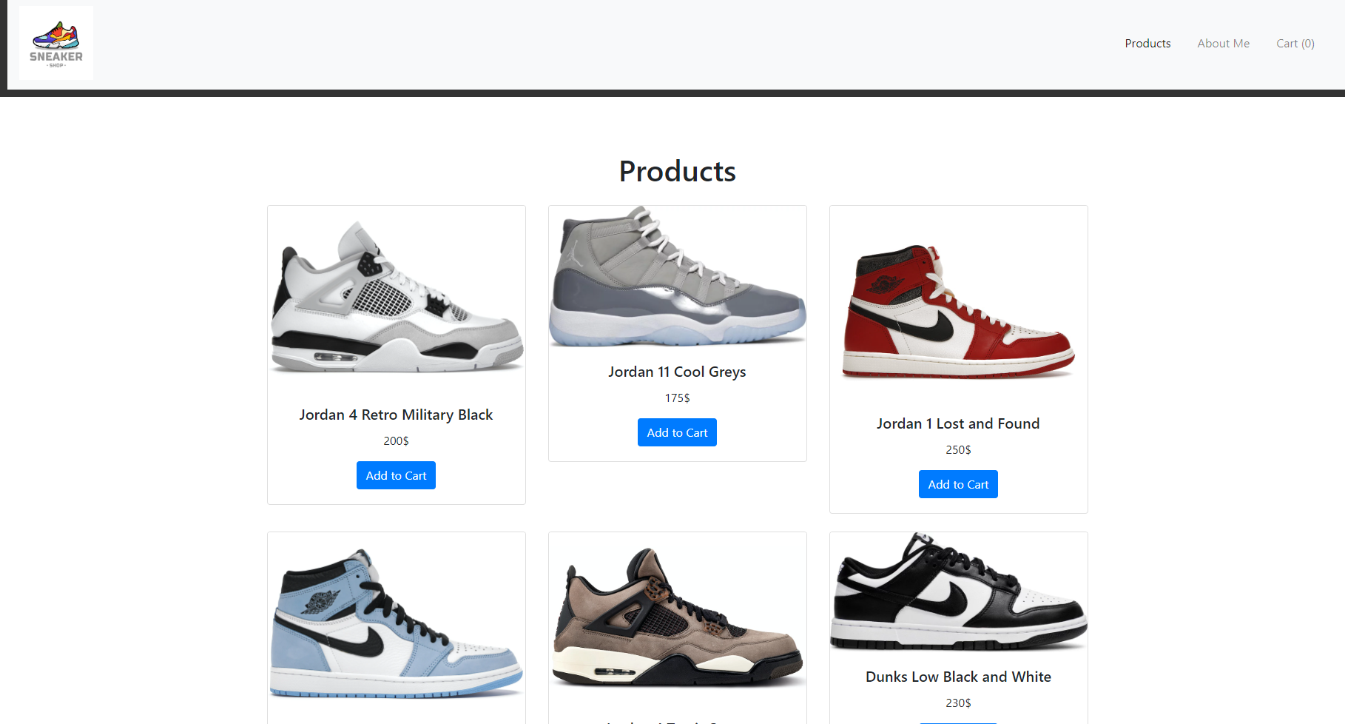
Products Page
It has a few sneakers listed with their prices and a button that adds that sneaker to the cart

Slide 8
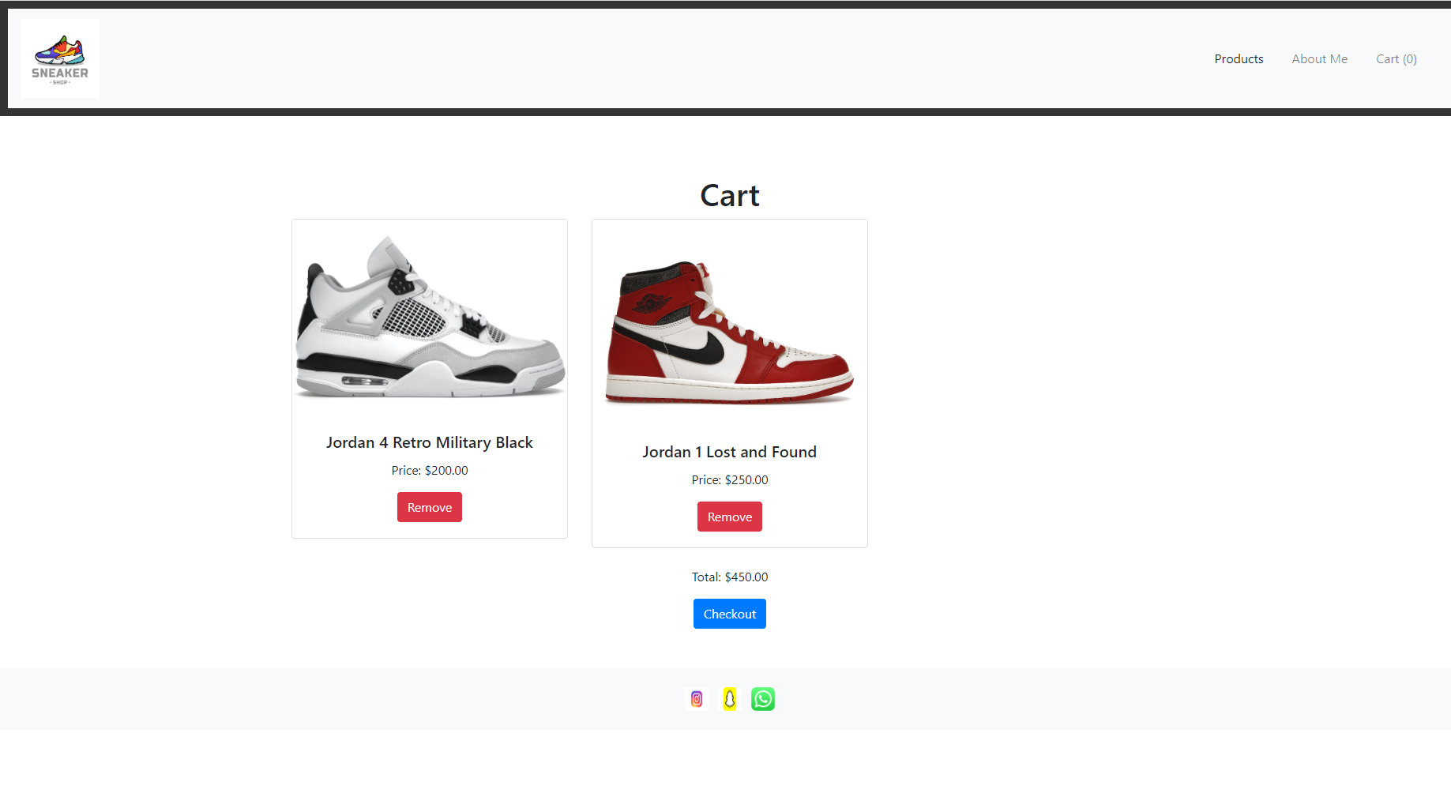
Cart
In the cart page you can find the items u added from the products page and it has a calculator that give you your total

Slide 9
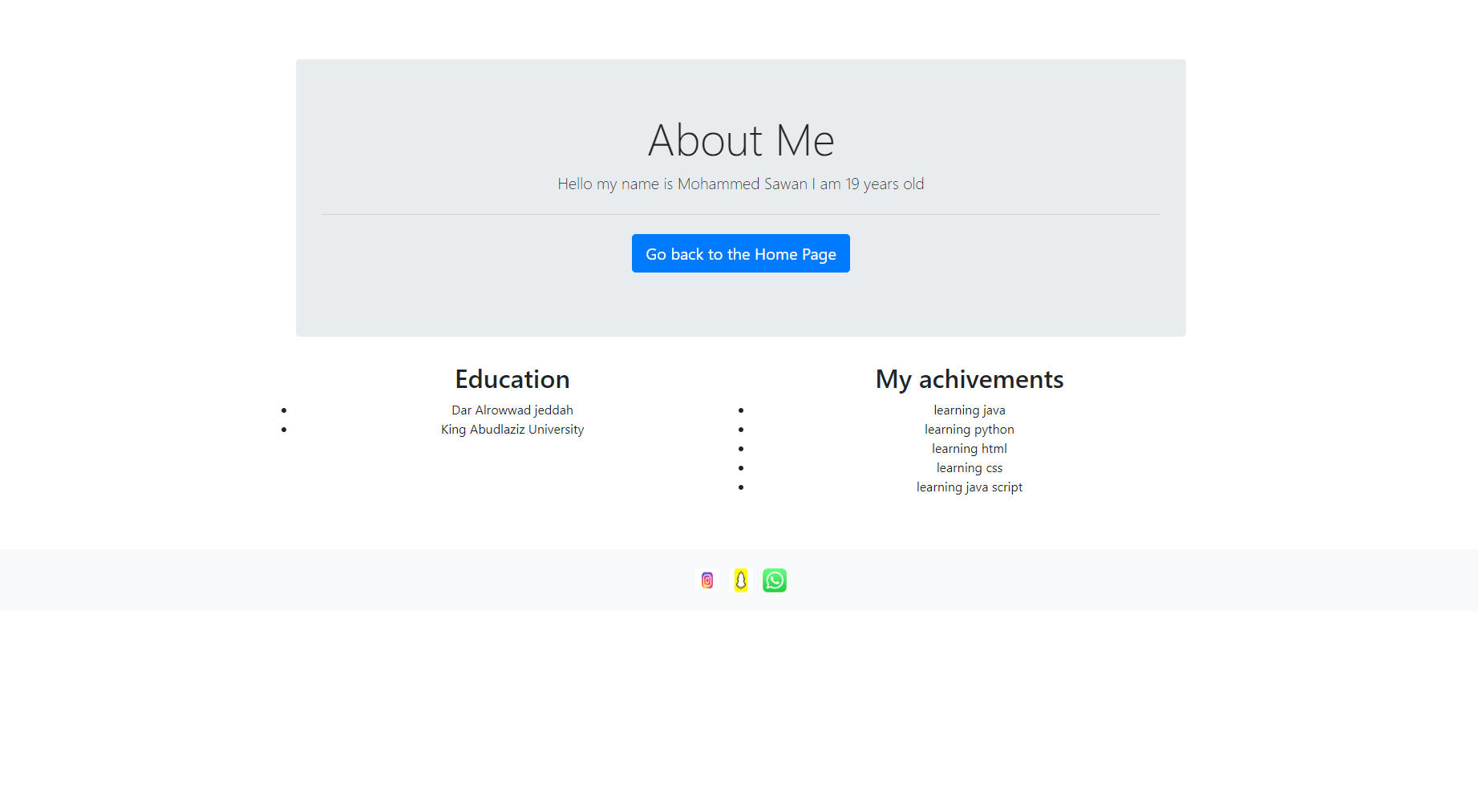
About Me Page
The about me page has a button that takes u back to the home page plus information about myself

Slide 10
External Links
Java Script:
<script src="cartScript.js" defer></script> for the cart calculator and remove button
<script src="script.js" defer></script> to connect the product and cart pages
BootStrap
<script src="https://code.jquery.com/jquery-3.5.1.slim.min.js"></script>
<script src="https://stackpath.bootstrapcdn.com/bootstrap/4.5.2/js/bootstrap.min.js">
</script>
<link href="https://stackpath.bootstrapcdn.com/bootstrap/4.5.2/css/bootstrap.min.css" rel="stylesheet">
Css
<script src="script.js" defer></script>

Slide 11

Thanks

